Slide 1
Week 13 Interpretable ML

Slide 2
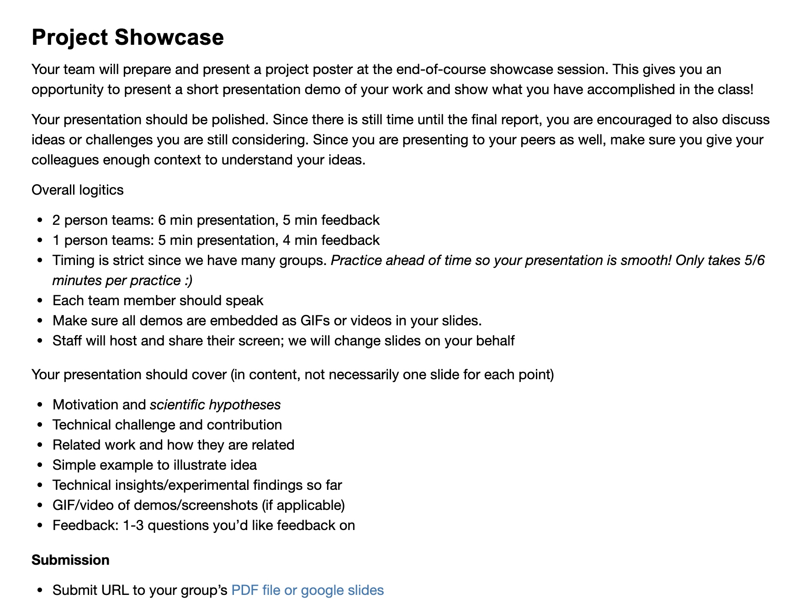
Administrivia
Thank you for the insightful reviews!
Showcase in 2 weeks

Slide 3
Showcase Logistics
9 groups
2 person teams: 6 min presentation, 5 min feedback
1 person teams: 5 min presentation, 4 min feedback
Timing is strict, so practice!
Every team member should speak
Submit slides by Monday night before showcase
Staff will share screen for all presentations

Slide 4
Showcase Details
Presentation should contain (in substance, not necessary slides)
Motivation and hypotheses
Technical challenge and contribution
Related work and how they are related
Simple example to illustrate idea
Technical insights/experimental findings so far
GIF/video of demos/screenshots (if applicable)
Feedback: 1-3 questions you’d like feedback on

Slide 5
Recall
If project is a perceptual/user study
Focus is on the task that the study will better illuminate
Show: new understanding of users
If project is a system/tool/interaction design
Focus is on the task that is improved
Show: novelty, performance, ease of use
If project is an algorithm
Focus is an existing or new task
Show: novelty, correctness, scalability

Slide 6
The Building Blocks of Interpretability
Presenter: Deka Auliya Akbar
Scribe: Yin Zhao
Stop Explaining Black Box ML Models
Presenter: Yin Zhao
Scribe: Deka Auliya Akbar

Slide 7
Building Blocks of Interpretability
Authors: Chris Olah, Arvind Satyanarayan, Ian Johnson, Shan Carter, Ludwig Schubert, Katherine Ye, Alexander Mordvintsev
Presenter: Deka Auliya Akbar (da2897@columbia.edu)

Slide 8
Today’s Schedule
Introductory Materials: Models and Interpretability
Basic Concepts - NN
Related Works and Contributions
Presented Ideas
Discussions

Slide 9
Models and Interpretability
Notes:
connection between HDI and Models

Slide 10
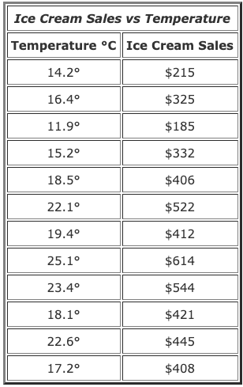
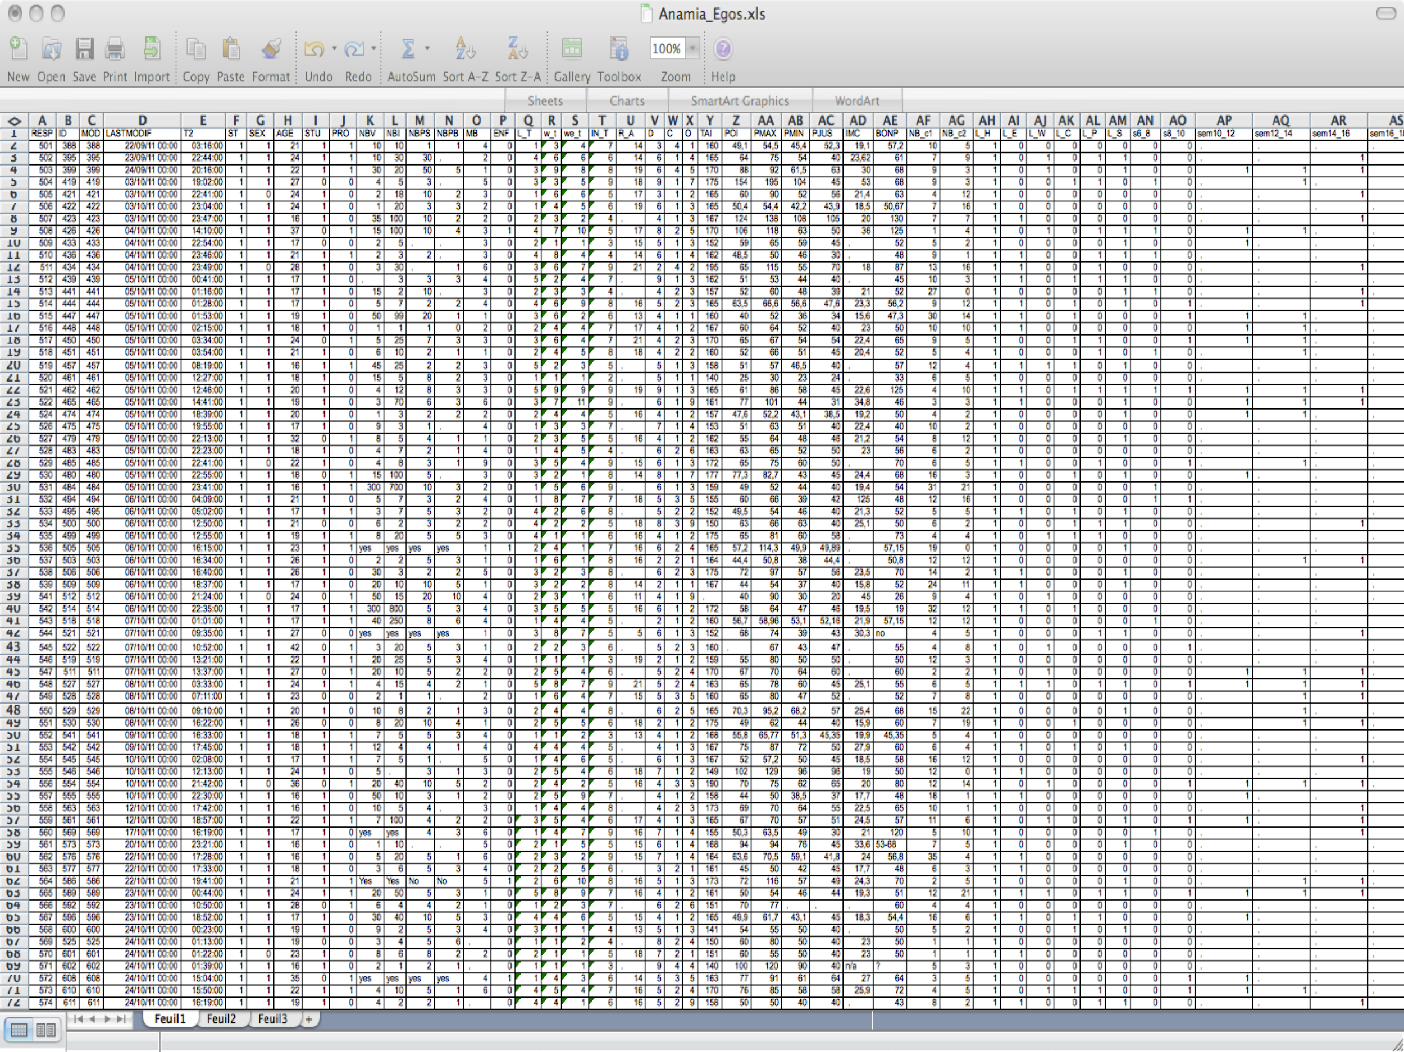
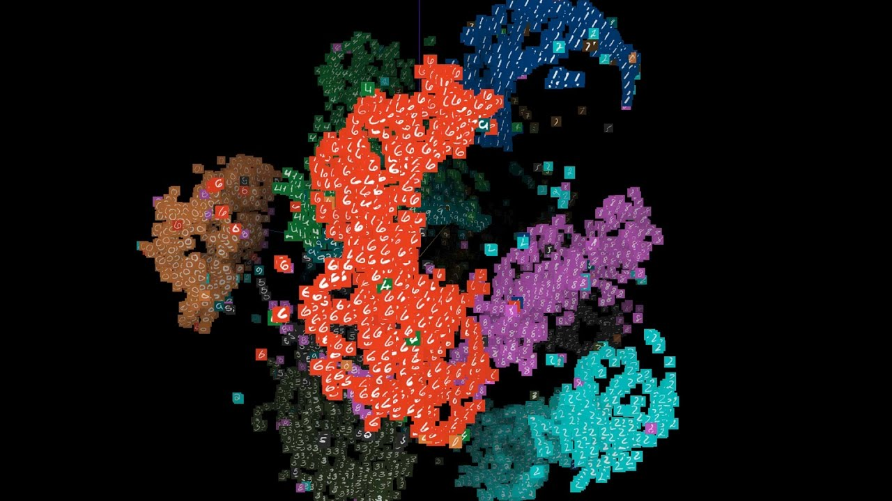
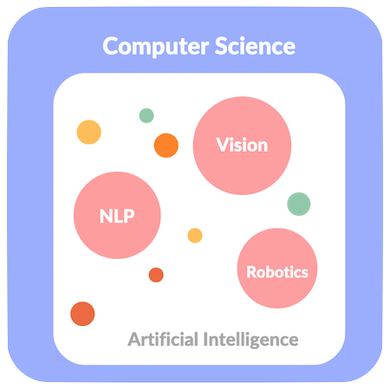
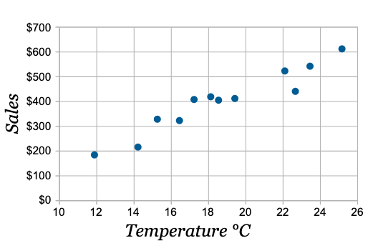
Quick Intro to Models
Multidimensionality
Large Data
universe
data
Subset of Data
Task Complexity
Data Visualization is not Enough
Notes:
n-dimensional
huge data size
assumption

Slide 11
Quick Intro to Models
Make Prediction
Regression
Classification
Extract Information from Data
Discover Patterns
Discover Relationships
Represent data in other forms
Clustering
Data
Model
f(x)
compact data representation
Output

Slide 12
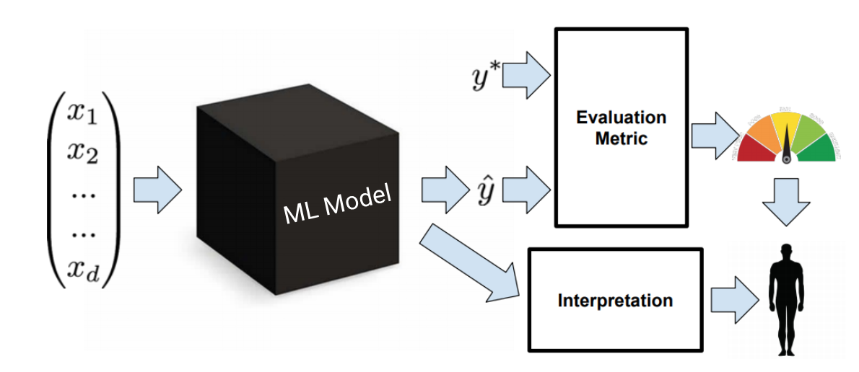
Quick Intro to Models
Training a model: the process where model learns from data to optimize an evaluation metric
Training data: data sample
Inside the Model:
Weights / Parameters
Transformations
Hidden Representation
Assumption: good performing models represent the data well

Slide 13
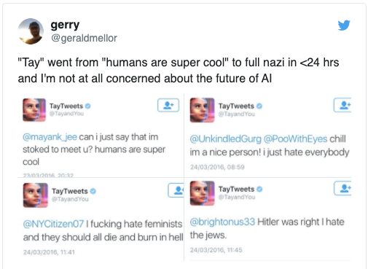
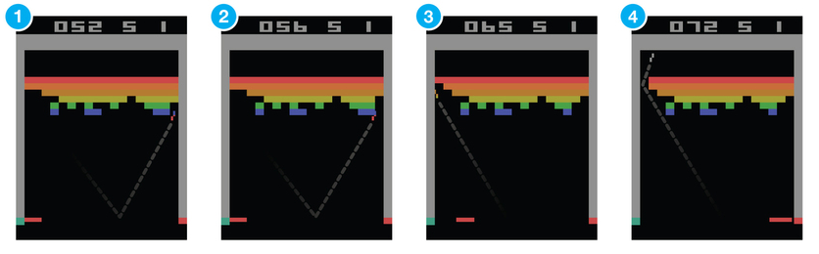
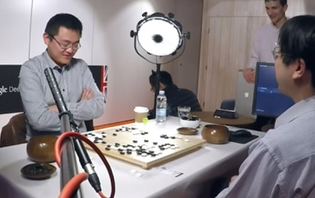
Why Interpretable Models
Extract Information from Data
Discover Patterns and Relationships
Represent data in other forms
Clustering
Control over Model
prevent mistakes or biases unintentionally learned by the model
Augment Human Knowledge and Intelligence
Learn new Techniques

Slide 14
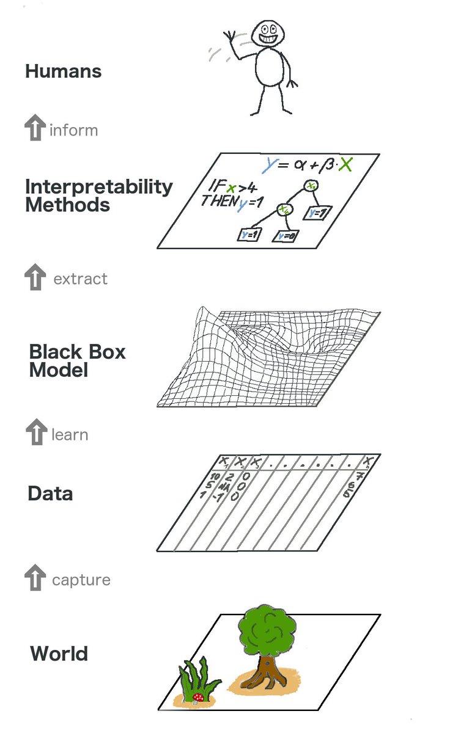
Why Interpretable Models
Assumption: good performing models represent the data well
Data
Model
f(x)
compact data representation
Output

Slide 15

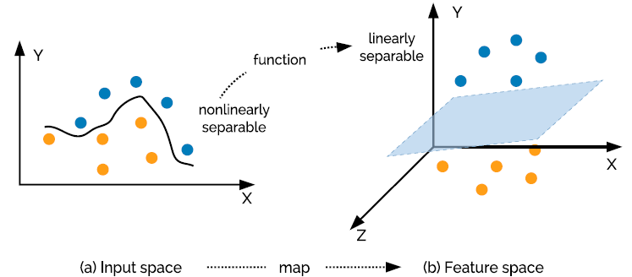
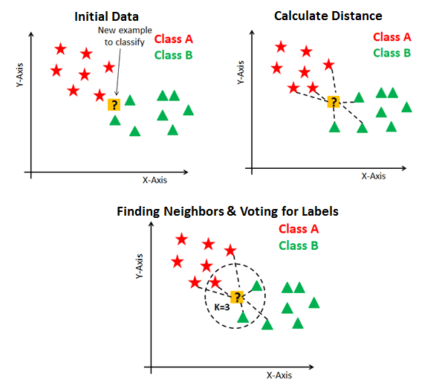
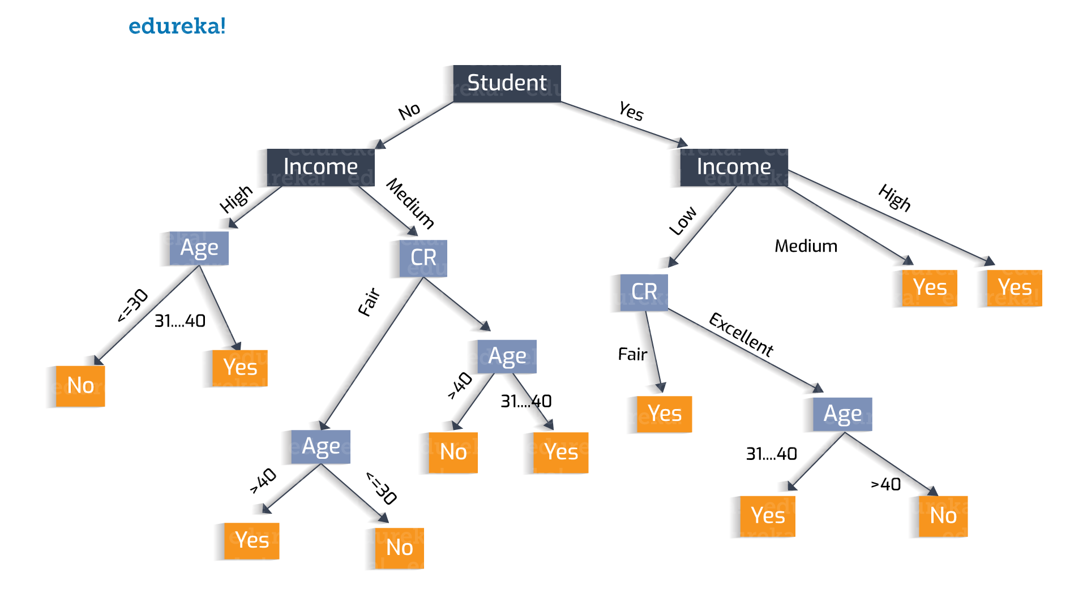
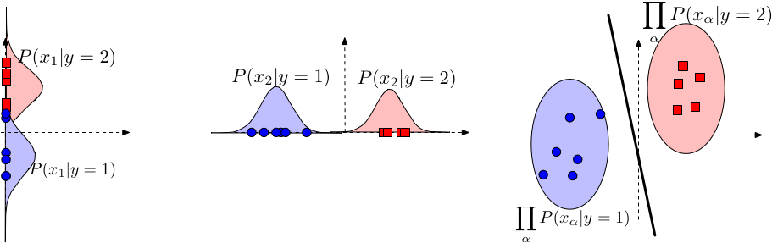
Quick Intro to (Supervised) Models
Linear Models
Decision Tree
K Nearest Neighbour
Probabilistic / Naive Bayes
Supervised Vector Machine
Neural Network
...

Slide 16
2. Intro to NN

Slide 17
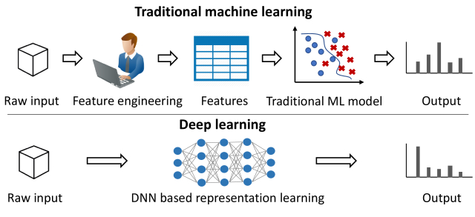
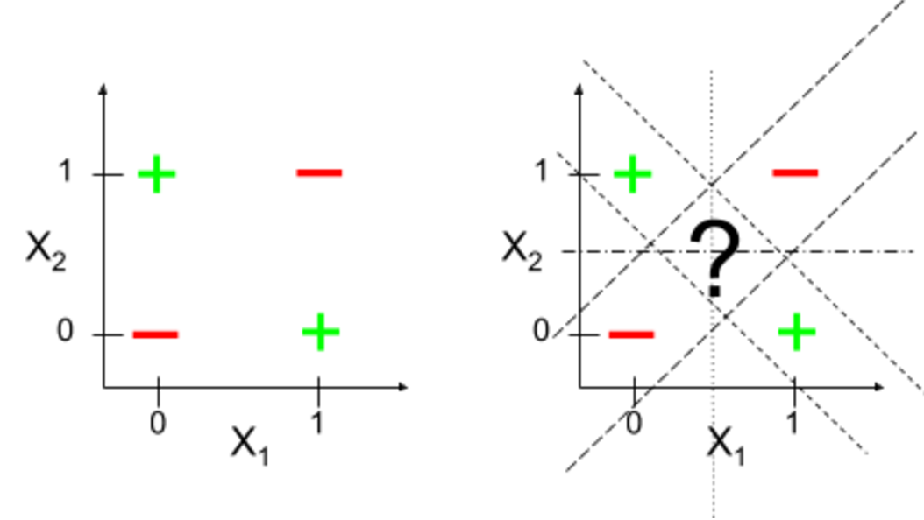
Quick Intro to NN - Motivations
Representation Learning: Automated ‘Feature Engineering’ capabilities
Hidden Latent Features
Automatic Parameter Tuning
Scalability (with enough computational resources + ‘proper’ network architecture)
Training
Model Searching
Prediction
Performance on Complex Tasks
Most complex problems are nonlinear
eg: Computer Vision, NLP

Slide 18
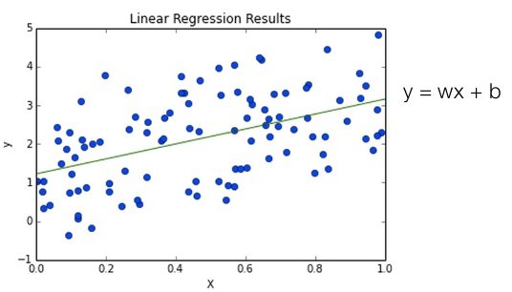
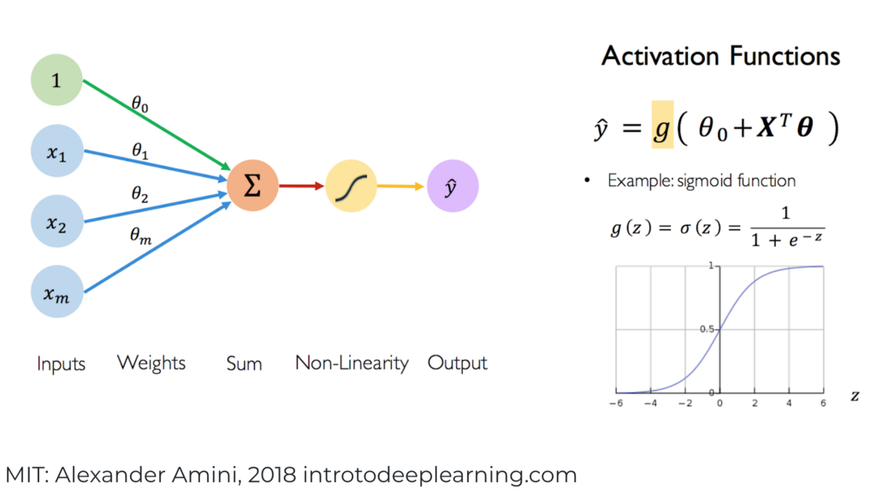
Quick Intro to NN - What
Inspired from Human Brain
Composable Functions
Non-Linear
Linear
Components:
Unit: Neurons
Edge: Weights
Activation / Transfer Functions
Output of Neuron / Activation Function: activation
Layers

Slide 19
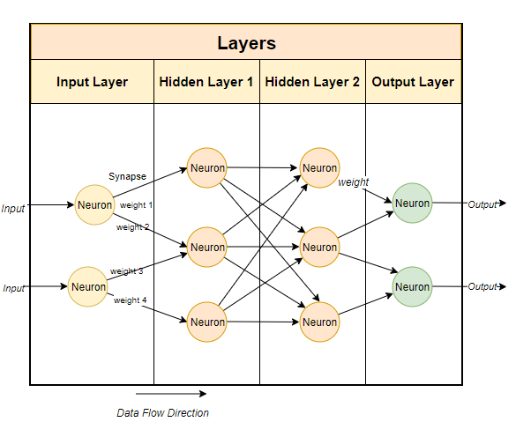

Quick Intro to NN - What
Inspired from Human Brain
Composable Functions
Non-Linear
Linear
Components:
Unit: Neurons
Edge: Weights
Activation / Transfer Functions
Output of Activation Function / Neuron: activation
Layers:
Input
Hidden: outputs of previous layer became the input of next layer
Output
Interconnected Neurons: Neural Network

Slide 20
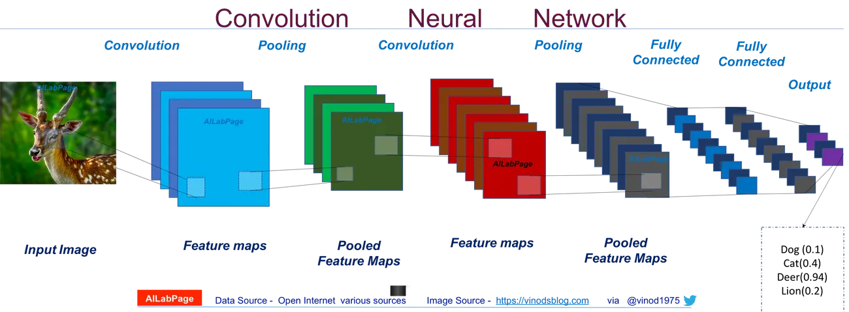
Quick Intro to NN for Computer Vision
Layers: consist of neurons and channels, outputs activations
Convolution and Pooling Layers: Detecting Spatial Features, Shapes, Styles (Color), etc. → automatically learned by NN
Fully Connected Layer: prediction task
Channels: detector, eg: RGB, Abstract Channels, etc.
Input Image: RGB Pixels
Transfer Learning: Reusability
Notes:
Reusability
Image-understanding systems (IUS) include three levels of abstraction as follows: low level includes image primitives such as edges, texture elements, or regions; intermediate level includes boundaries, surfaces and volumes; and high level includes objects, scenes, or events. Many of these requirements are entirely topics for further research.

Slide 21
3. Related Works and Contributions

Slide 22
Prior Works
Interpretability is usually studied in isolation
Most just relates the features / hidden features to output instead of studying the relationships between parameters / hidden features
In context of NN, this is related to hidden layers
Doesn’t consider the building blocks of the model and the relationships between them
Interpretability Concepts:
Activations
Attributions + Saliency Maps

Slide 23
Main Contributions
Distilling (black box) Models
Specifically in Deep Nets
Abstraction over Interpretability:
derive interpretability blocks
interfaces for interpretability blocks
Explore powerful interpretability interfaces by combining the combinatorial interpretability space

Slide 24
4. Presented Ideas

Slide 25
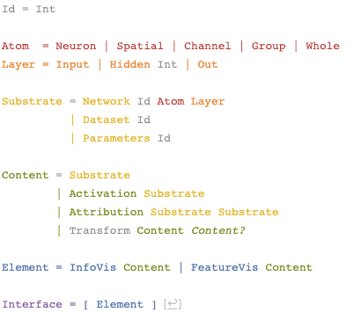
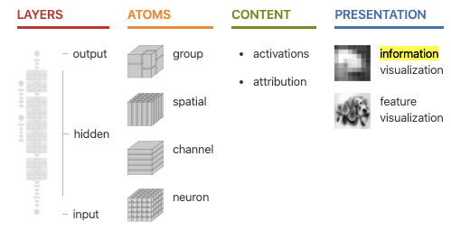
Building Block of Interpretability
Navigate the interpretability abstractions and space of interpretable interfaces: Substrate, Content and Presentation Elements
Presentation > Content (Interpretability Concepts) > Substrate (Model and Data)

Slide 26
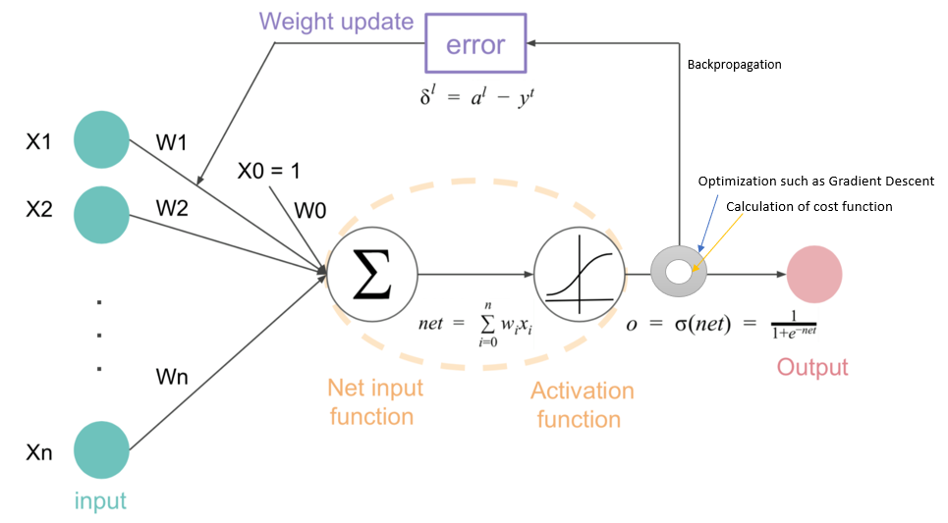
Content - Main Questions
What does the model recognizes / detects / sees: activation
the outputs of the models
presentation: feature visualization
How does the model behave / make decisions: attribution
what caused the behavior
how the weights and activations affect the model’s decision
approximates the relationships between input/hidden features to target / higher level ideas
presentation: saliency maps
What changes affect how the model behave: gradient
what changes the behavior of the model
presentation: heatmap

Slide 27
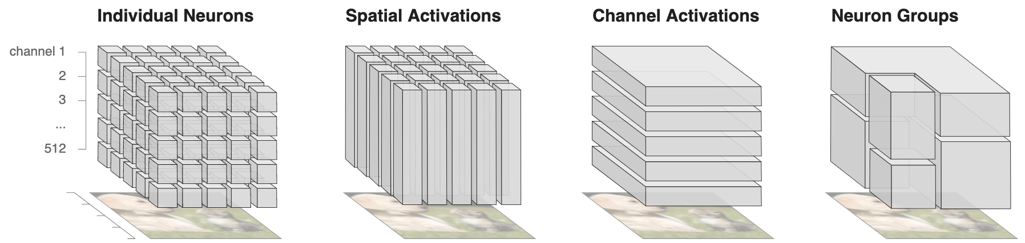
Atom
Individual Neurons
Spatial Activations
Channel Activations
Neuron Groups
Notes:
Cconsider arbitrary groupings of llocations and channels

Slide 28
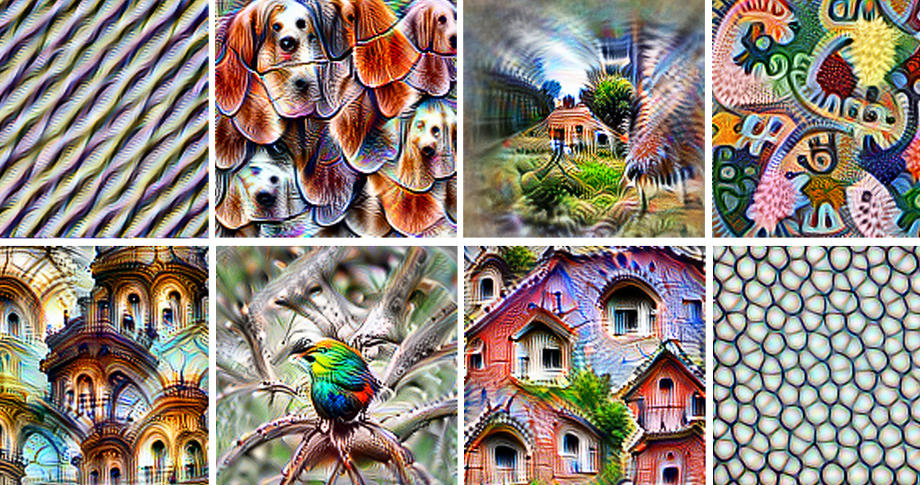
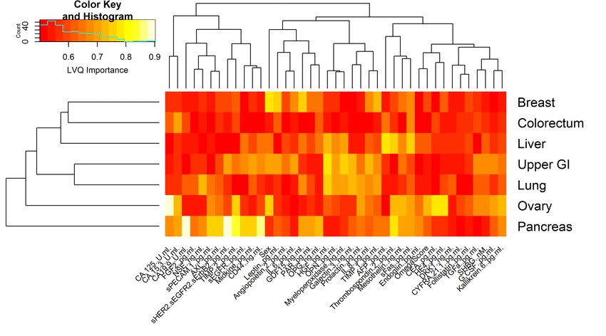
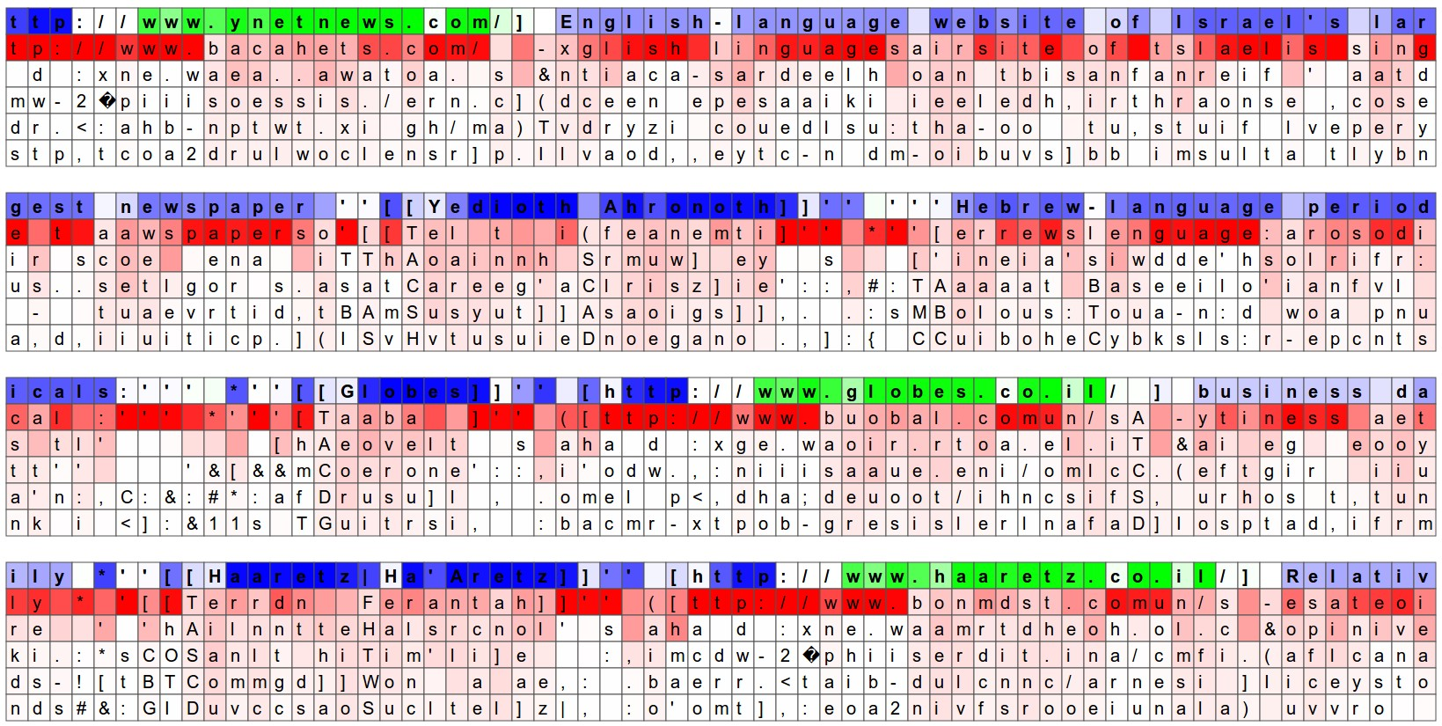
Presentation Elements
Information Visualization
Visualize Coefficients directly
Heatmaps
Feature Visualization
Notes:
http://karpathy.github.io/2015/05/21/rnn-effectiveness/
HeatMap
Feature Importance

Slide 29
Making Sense of Hidden Layers
Answers what does the model recognize → activations
Understanding abstract vectors of activations is difficult → Semantic Dictionaries and Feature Visualization
Semantic dictionary: maps neuron activation to visual representations
higher level meaningful abstractions (vision → visuals, audio → sounds)
bring meaning to layers → composable building blocks: combine units, mapping between layers
Notes:
target the activations of individual neurons, spatial positions and channels

Slide 30
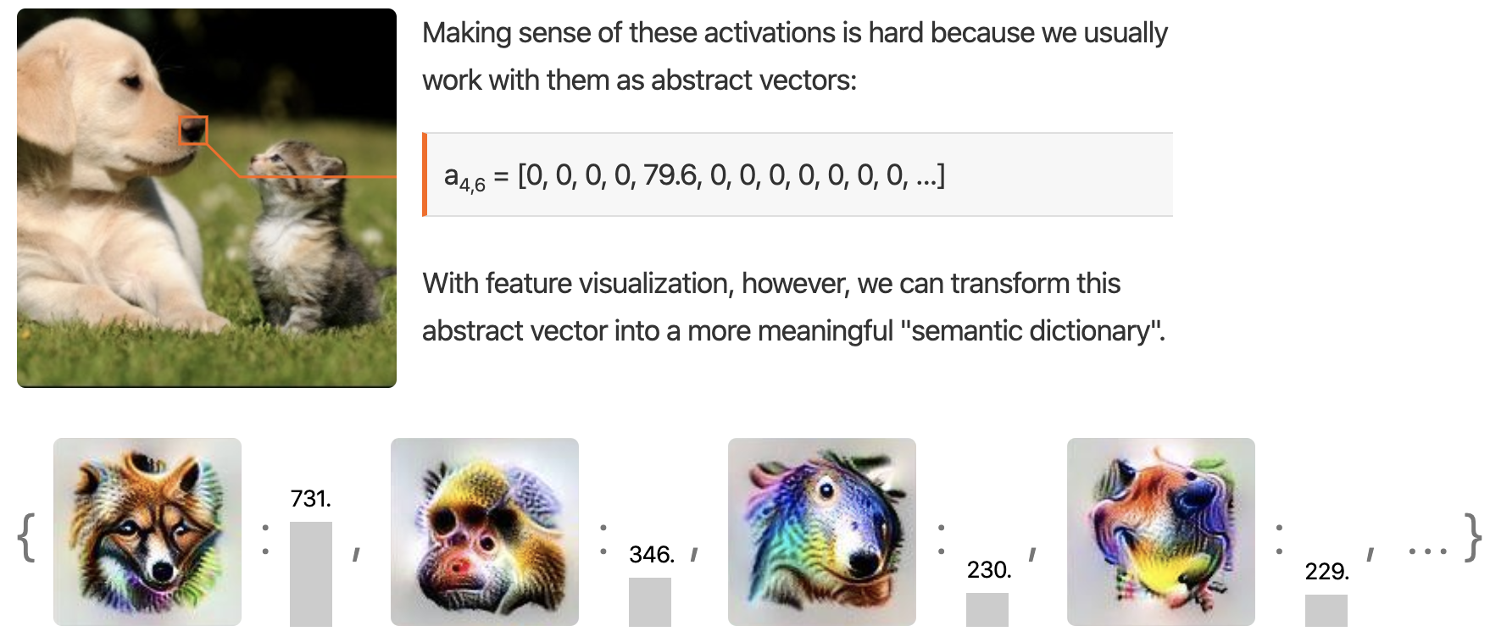
Making Sense of Hidden Layers
Atom: neurons in a layer, channel, and spatial grid
Interface: Allows user to interact and ‘see’ what the neuron sees for set of neurons in a spatial grid, channel, and layer
https://github.com/tensorflow/lucid
https://colab.research.google.com/github/tensorflow/lucid/blob/master/notebooks/building-blocks/SemanticDictionary.ipynb
Vector of Neurons / Activation Vector in a Spatial Grid
Channels
Notes:
per one layer

Slide 31
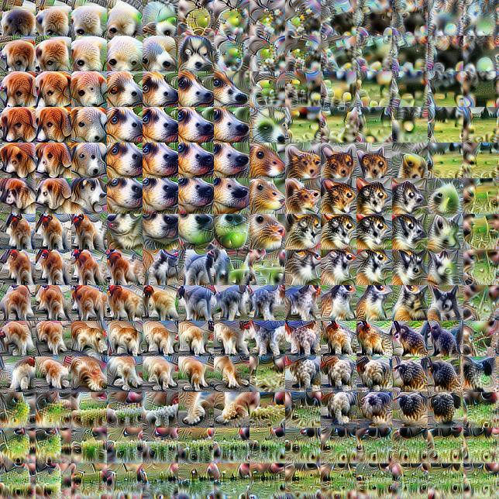
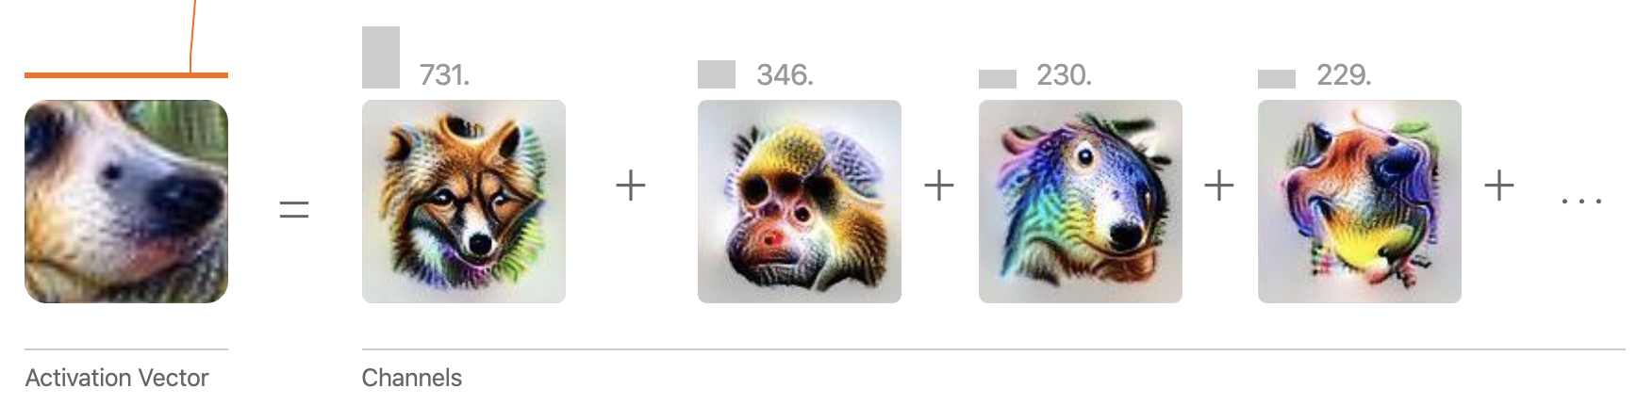
What Does the Network See?
See what the network detects at each position → Activation Grid
Visualization the combination of neurons (activation vector) that fire at a given spatial location → consider activation vectors as a whole
combine activation vectors of different layers
Activation Grid
Notes:
visualizing layer: each layer has several channels, combine neurons at these channels having the same spatial locaiton
interface: the interface for interacting with neurons

Slide 32
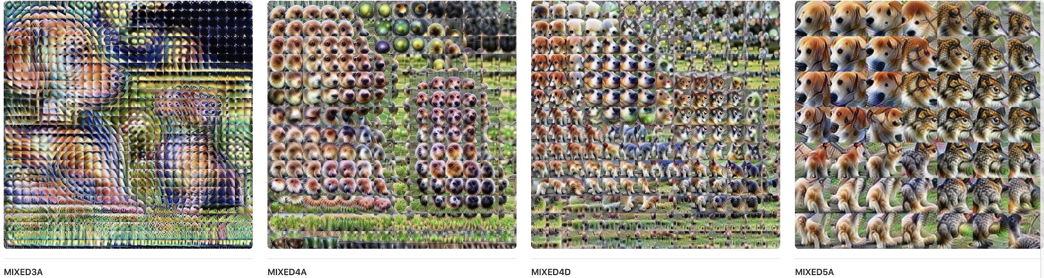
What Does the Network See?
Patterns: detect abstract image constructs (edges, textures, etc.) in earlier layers, to more sophisticated shapes and object parts in the later layers
Problem: Magnitude of the activations are not visible
Notes:
visualizing layer
interface: the interface for interacting with layers

Slide 33
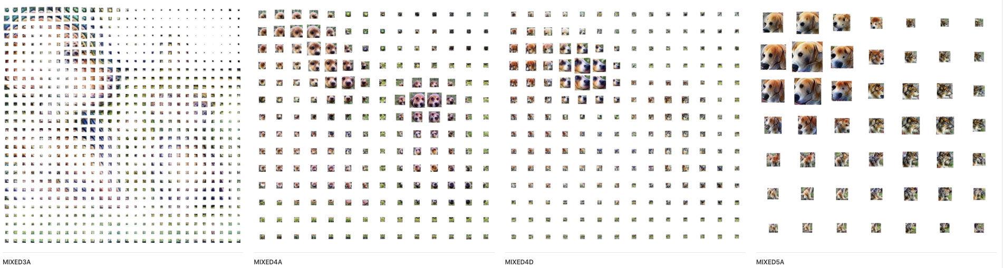
What Does the Network See?
Scale the feature visualization area by the magnitude of the activation vector
Notes:
visualizing layer
interface: the interface for interacting with layers

Slide 34
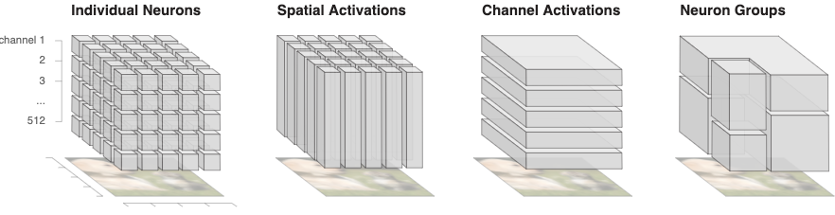
How Concepts are Assembled?
Attribution: answers how decision is made by the model by explaining the relationships between neurons → saliency maps
problems with traditional saliency maps:
pixels as attribution unit is problematic: entangled with other pixels, not robust under transformation, far from high-level concepts
limited interface: attribution to output/class, not between points or hidden layers
treat attribution as building block → what high-level ideas are important
Proposed Attribution Interfaces:
Spatial Attribution
Channel Attribution
Notes:
interface: the interface for interacting with attributions

Slide 35
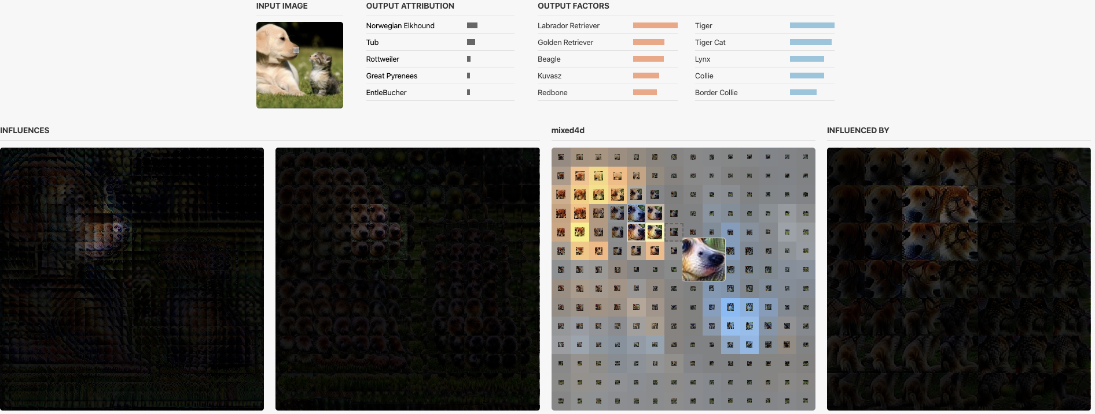
How Concepts are Assembled?
Spatial Attribution
attribution unit: hidden layer / detectors → flexible relationships for attribution
how activation grid affects the output label or between hidden layers → layer-to-layer attribution
atom: spatial grid of a layer spanning group of neurons and channels
interface: overlaying saliency maps on top of activation grid
apply attribution to spatial locations of a hidden layer
interact between layers to output and other layers
Notes:
interface: the interface for interacting with attributions
attributions

Slide 36
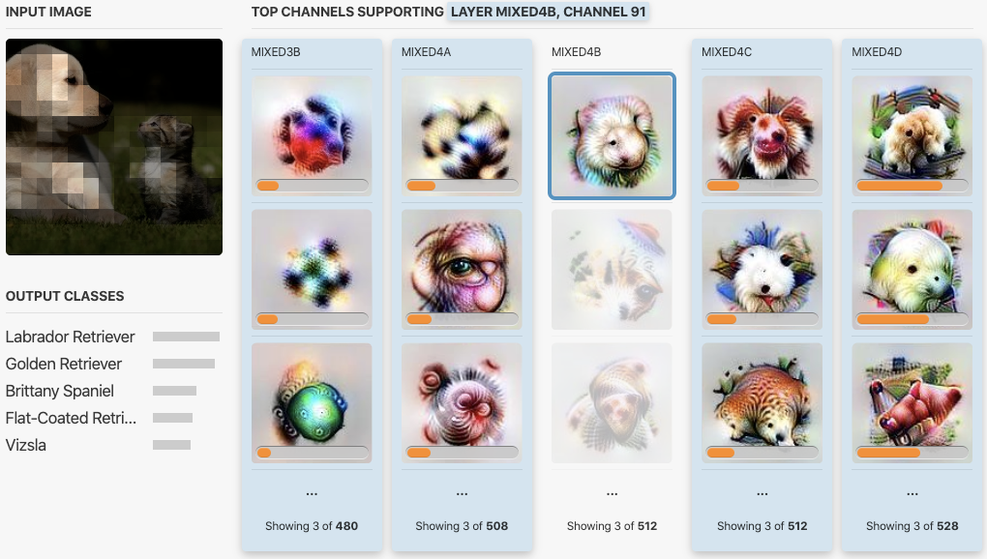
How Concepts are Assembled?
Channel Attribution
Problem with spatial attribution: aggregates over channels, which detector is most useful?
Slice by channel, layer-to-layer attribution over channels
How each channel / detector contribute to the output?
Interface:
interact with channel attribution
heatmap activation on image
layer-to-layer attribution
Problem: Information Overload
aggregation: loss of information
not aggregation: information explosion
Notes:
interface: the interface for interacting with attributions
attributions
, displays the attribution on channel level + sorting

Slide 37
Making Things Human-Scale
Handle Information Overload: Find Good and Meaningful Information Decomposition
Groupings of neurons
Dimensionality Reduction and Matrix Factorization
Atom: groups of neurons, combinations of spatial locations and channels.
Tradeoff between information and reducing info to human-scale
Use the objective/goal of the interface to influence how grouping is done
What the network detects: activation
How the network behave: attribution
How changes in the network change the network behaviour: gradients
How layers are connected: layers
Notes:
interface: the interface for interacting with high-level activations and attributions for humans

Slide 38
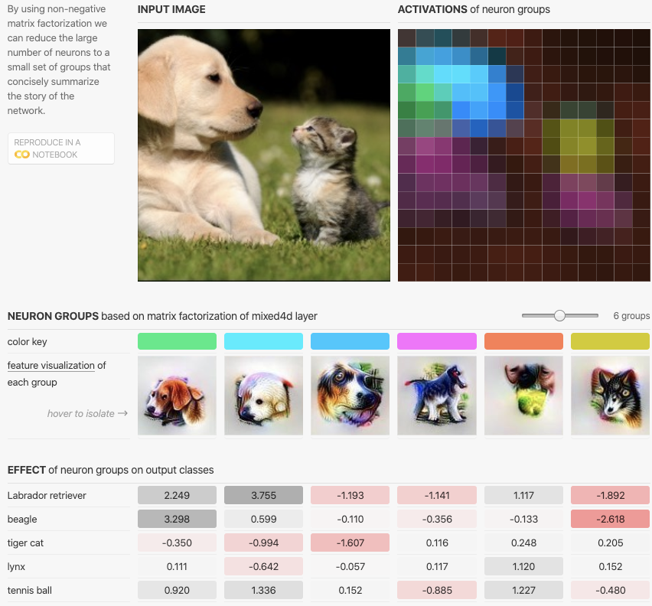
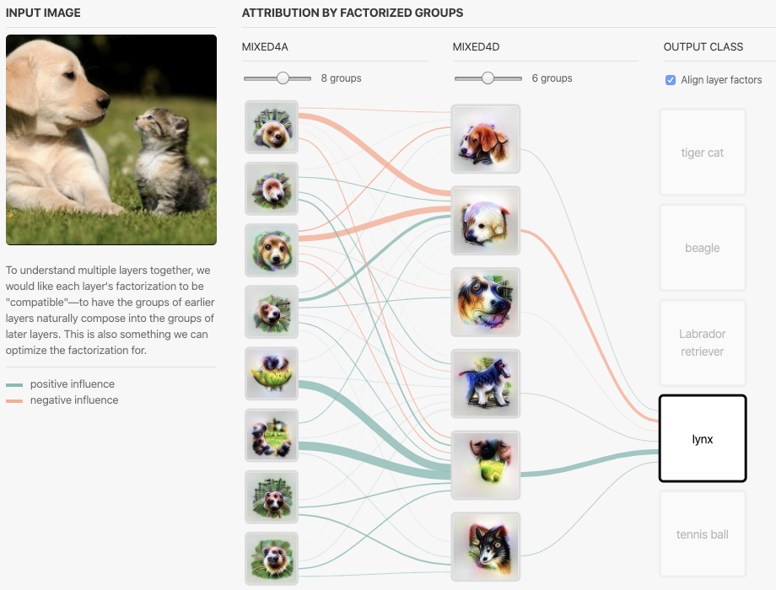
Making Things Human-Scale
Interface
interact with neuron groups and its effect on output
heatmap on image
interact within a single or across layers
Notes:
interface: the interface for interacting with high-level activations and attributions for humans

Slide 39
Building Block of Interpretability
Interface: union of elements
goal / objective: ultimately for human consumption
questions about the model: contents
presentation elements
model
parameters
units / components
relationships between units

Slide 40
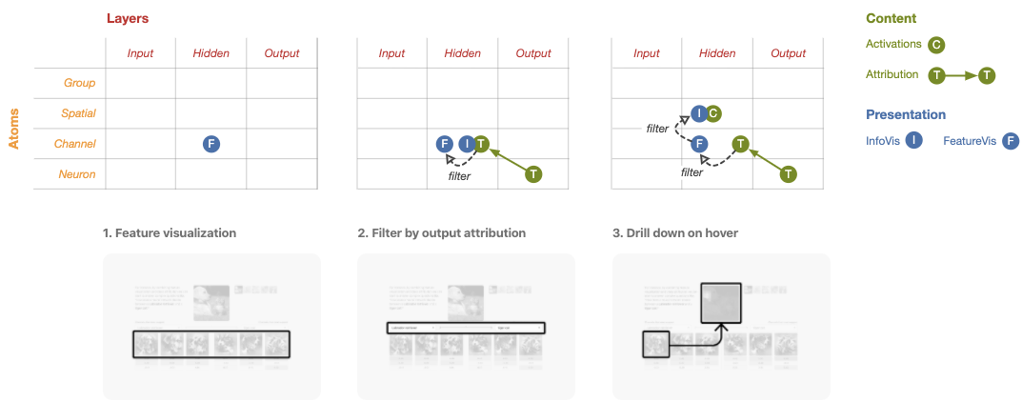
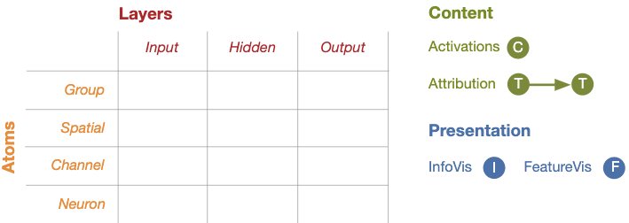
Building Block of Interpretability
Interface: union of elements
Explore space of interpretability

Slide 41
Trustworthiness of Interpretability Interfaces
Ensure interface is not misleading
Possible Improvement:
Human Feedbacks
Model Performance
Developing techniques that achieve broader coverage of model behavior

Slide 42
5. Discussions

Slide 43
Discussions
Do you think the abstractions discussed in the paper applicable to all models?
What do you think of distill.pub as a publication platform?
What do you think of interpretability vs explainability?
How do we evaluate the trustworthiness of model’s interpretability?
Does interpretability really matters if the model performs really well?

Slide 44


Closing
Human
Data
Interfaces
Data Visualization
Data Processings
Data Modelling
etc.
Human Experts are (Natural) Model

Slide 45
Thank You

Slide 46
Stop Explaining Black Box ML Models for High Stakes Decision
And Use interpretable Models Instead
Cynthia Rudin

Slide 47
Introduction
Main concern of this paper is on high stake decision making problems and trouble shooting.
This paper concerns the problem of the increasing use of black box machine learning models in healthcare and criminal justice.
The black box models do not have explanation of their predictions such that humans can understand.
The shortcoming of such methods lead to severe consequences in these fields in particular because these are mistake intolerant
“Explainable ML”: a second (posthoc) model is created to explain the black box model

Slide 48
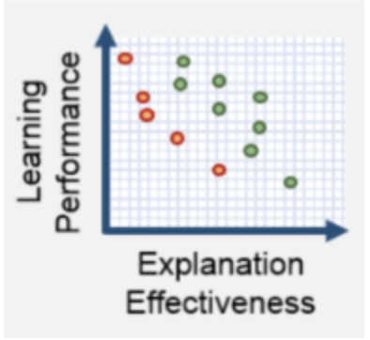
Issues with Explainable ML
Accuracy vs. Intepretability
“Explainable” refers to understanding how a model works, not how the world works.
There is necessarily a trade-off between accuracy and interpretability. Common belief that more complex models are more accurate is not true, especially for structured data.
DARPA Explainable Artificial Intelligence program’s broad agency announcement exemplifies a blind belief:
Type to enter a caption.

Slide 49
Issues with Explainable ML
Explanations not faithful to what the original model computes
Explanations must be wrong.
Explainable model can use completely different computations from the original model, thus not faithful.
“Explanation” does not attempt to mimic the calculations made by the original model.
Example of COMPAS recidivism model: racially biased

Slide 50
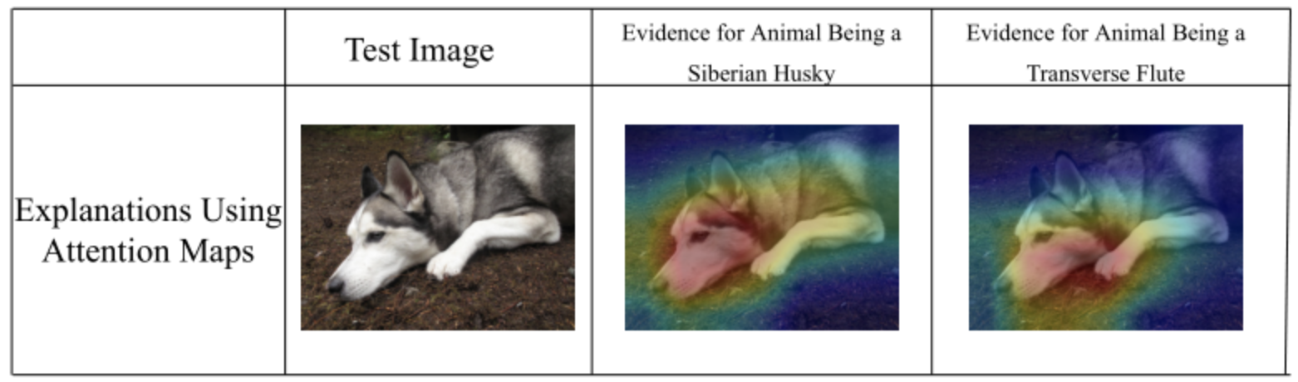
Issues with Explainable ML
Explanations often do not provide enough detail to understand the original model
Leave out too many details and information
Example: saliency maps
Determines what part of the image is being omitted by the classifier, but not how relevant information is being used.
Type to enter a caption.

Slide 51
Issues with Explainable ML
Risk assessment
Considerations outside the database that needs to be considered for risk assessment.
In such situations, black box makes it very hard to calibrate these information into the model.

Slide 52
Issues with Explainable ML
Human error
The consequence of human error (typographical) would be enlarged by overly complicated (black box) models.
We cannot notice the flawed model, because it’s hard to troubleshot.

Slide 53
Issues with Interpretable models
Companies can’t make profit from transparent models
Keeping models not transparent would prevent them from being reverse-engineered.
Solution/counter argument:
If the models are good enough, transparency would improve the quality of the system.

Slide 54
Issues with Interpretable models
Effort to construct: computation and domain expertise
Solving application-specific constraint problems
however, for high-stake decision tasks, the cost of making mistake is much more than the cost of expertise time.
Black box models may discover hidden patterns
Authors point: however, if the patterns are important enough to make black box do better in prediction than the interpretable model, those would be captured by the interpretable model as well.

Slide 55
Encouraging Responsible ML Governance
Proposal 1: No black box should be deployed when there exists an interpretable model with the same level of performance
This proposal solves the issue #1 with interpretable models talked earlier
This change would result in companies / developers not making profit from licensing the model, but provides public benefits.
Proposal 2: Organizations report accuracy of interpretable modeling methods.
Avoid blindly using black box models, which would result in criticism.

Slide 56
Algorithmetic Challenges in Intepretable ML
Constructing optimal logical models
Logical models: statements involving “or”, “and”, “if-then”, etc.
Many heuristics for constructing logical models (greedy)
Not globally optimal.
Optimization problems to solve the objection known to be computationally hard.
Reduce search space
Libraries to allow fast exploration of search space
Specialized data structures that keep track of intermediate computations and symmetries

Slide 57
Algorithmetic Challenges in Intepretable ML
Construct optimal sparse scoring systems
Second challenge: create algorithms for scoring systems that are computationally efficient.
Scoring system: a sparse linear model with integer coefficients (point scores)
Again, computationally hard.
New cutting plane algorithms have great performance: Risk-Supersparse-Linear-Integer-Models

Slide 58
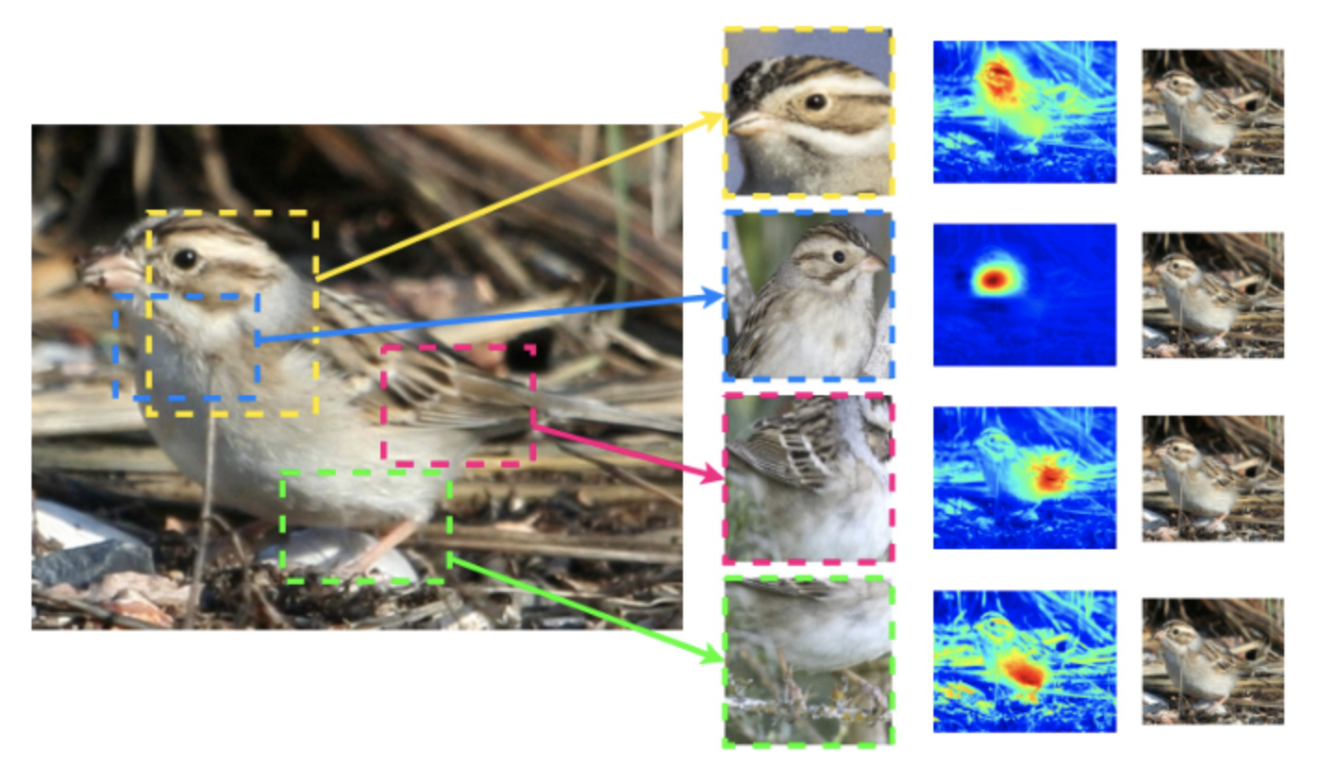
Algorithmetic Challenges in Intepretable ML
Define Interpretability for Specific domains and create methods
Construct network architectures for deep learning that can explain why certain parts of the image are important in the model.
The network then makes decisions by reasoning about parts of the image so that the explanations are real.
Example: CV (the bird)
Real explanations: prototypes
And weighted similarities to them
Type to enter a caption.

Slide 59
Technical Reason Accurate Interpretable Models Might Exist
Rashomon set argument
Define the Rashmon set: the set of reasonably accurate predictive models.
Contains a large enough set of models with diverse predictions, it probably contains functions that are interpretable.
Argument:
Uncertainly arising from the data leads to a Rashomon set, a larger Rashomon set probably contains interpretable models, thus interpretable accurate models often exist.

Slide 60
Conclusion
Shift focus from the assumption that black box is necessary for accurate predictions
Encourage policy makers not to accept black box models blindly
Encourage more effort be made in ensuring safety and trust in ML models for high-stake decisions
Black box (and explainable) models may lead to poor decisions throughout high-stake areas.

Slide 61
Questions
Do you think the black box models (and explainable ML) causes bad consequence to the society and high-stake decision fields?
Is it true that there exist interpretable models in most domains? (Does the Rashmon set argument make sense in this situation?)
What are the pros of black box models that this article did not mention?
How realistic is it to construct interpretable models for many complicated tasks?

